Slide 1

Neural Networks
Jayanth Rasamsetti
Founder & Chief Scientist
www.sgmoid.com
Columbia University (MS)
IIT Madras (B.Tech & M.Tech)
jr3281@columbia.edu
https://www.linkedin.com/in/jayanthr/

Slide 2
Agenda:
Google Colaboratory, AWS Sagemaker
Day 1: Neural Networks workings, Training times, parameter tuning, MNIST, Adam, Relu, Other architectures
Test
Day 2: Working with Text Data, Sentiment Analysis
Test

Slide 3

Best Practices:
We will be very hands on! Blend of theory & lab
Very important to code every day 20 lines of Python code
Introduction to Google Colab (https://colab.research.google.com/notebook)
De-bug as much as possible every line of code
10 min rule: Try to debug for 10 min independently (either stack overflow, etc) and only then seek help (from a peer)
Tips to improve coding: Pair programming, long hours, competitions
Avoid copy pasting!

Slide 4

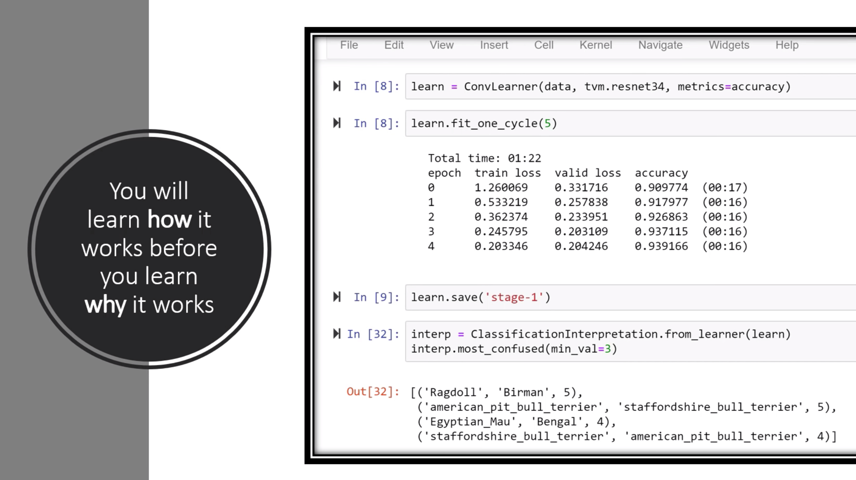
Case Method Style of teaching:
Traditional Method:
Concept > Exercise
Pros: Linear Flow
Cons: Dependent thinking, Fallacy in
structure
Case Study > Solve Exercise
Pros: Independent thinking, Research,
similar to most real life problems
Failing is good! Independent problem
solving is better!
Fail fast! Iterate faster! Debug faster!

Slide 5
Debug Checklist:
Spelling mistakes
Case sensitive, Parenthesis ( { [
Correct path to the dataset
Input libraries
Variable names
Indentation
Syntax
Shape mismatch
Type mismatch (numpy arrays)
Stackoverflow

Slide 6
Debug Checklist:
Follow the checklist to the letter
Look at the line number where the code broke
Search appropriately in Google the error
Look at stackoverflow, most people have similar errors
Read highly voted Stackoverflow comments only
Outcomes:
Atleast 30 lines of Python code/day. Debugged 10 errors. Independently.
Basic + Bonus. Outline of Machine Learning.
Positive Frame of mind and ready for the next steps (Decision Trees, Random Forests, Neural Networks)
Competitive Coding (Kaggle); Academic Research (IISc/IIIT/PGSSP), Startup

Slide 7

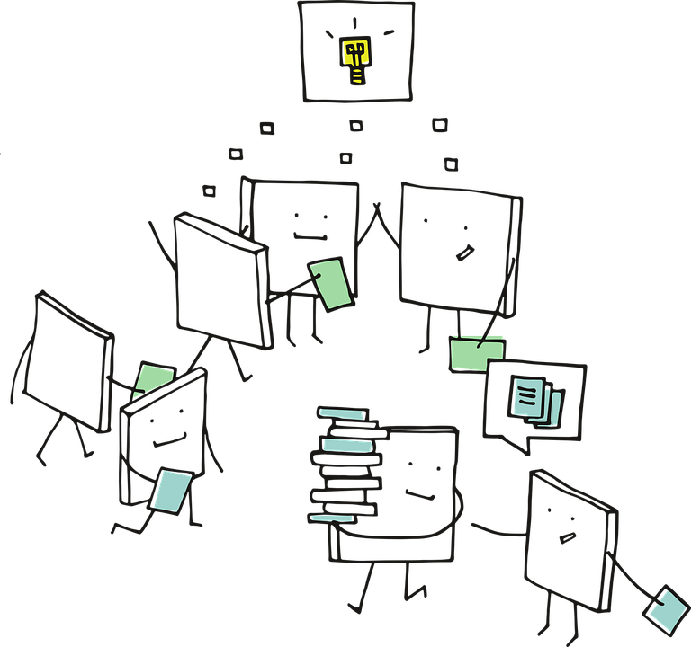
Working of
Neural Networks

Slide 8
RECAP

Slide 9
Hidden Layers
Input
Output
Number of weights

Slide 10
Hidden Layer
Input
Output
2 * 1
2 * 3

Slide 11
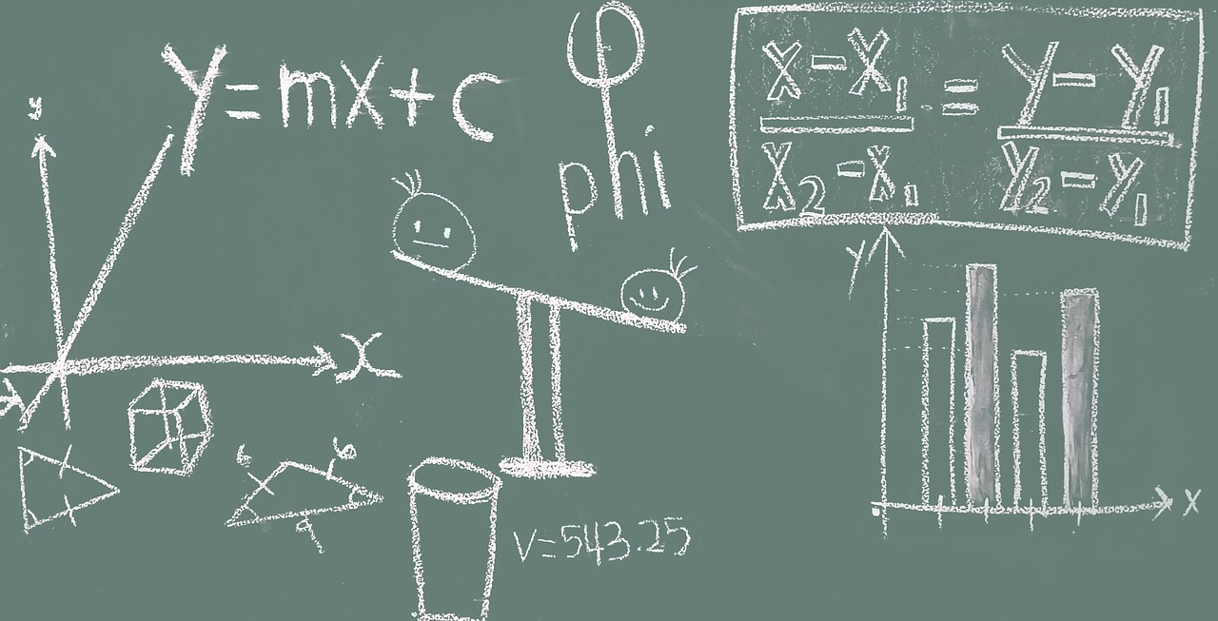
Math of Neural Networks

Slide 12
x₁ | x₂ | y
1 | 2 | 3
Requirement Data

Slide 13
Hidden Layer
Input
Output
1
2

Slide 14
Hidden Layer
W₁₁₁ =0.5
Input
W₁₁₂ =0.3
Output
1
2

Slide 15
h₁₁ = xW + b
W₁₁₁ =0.5
Input
W₁₁₂ =0.3
Output
1
2

Slide 16
h₁₁ = 1 * 0.5 + 2 * 0.3 + 1
W₁₁₁ =0.5
Input
W₁₁₂ =0.3
Output
1
2

Slide 17
h₁₁
2.1
W₁₁₁ =0.5
Input
W₁₁₂ =0.3
Output
1
2

Slide 18
h₁₁
2.1
o₁₁ = sigmoid(h₁₁)
W₁₁₁ =0.5
Input
W₁₁₂ =0.3
Output
1
2

Slide 19
h₁₁
2.1
o₁₁ = 0.89
W₁₁₁ =0.5
Input
W₁₁₂ =0.3
Output
1
2

Slide 20
h₁₁
2.1
o₁₁ = 0.89
W₁₁₁ = 0.5
Input
W₁₁₂ =0.3
h₂₁
Output
1
2
W₁₂₁ = 0.15
1.95
o₁₂ = 0.875
W₁₂₂ = 0.4

Slide 21
h₁₁
2.1
o₁₁ = 0.89
W₁₁₁ = 0.5
Input
W₁₁₂ =0.3
h₂₁
Output
1
2
W₁₂₁ = 0.15
1.95
o₁₂ = 0.875
W₁₂₂ = 0.4
W₁₃₁ = 0.65
h₁₃
1.05
W₁₃₂ = -0.3
o₁₃ = 0.741

Slide 22
h₁₁
2.1
o₁₁ = 0.89
W₁₁₁ = 0.5
W₁₁₂ =0.3
Output = 0.89* -0.23 + 0.875 * 0.83 + 0.741 * -0.56 + 1
Input
h₂₁
W₂₁₁ = -0.23
1
2
W₁₂₁ = 0.15
1.95
o₁₂ = 0.875
W₂₁₂ = 0.83
W₁₂₂ = 0.4
W₂₁₃ = -0.56
W₁₃₁ = 0.65
h₁₃
1.05
W₁₃₂ = -0.3
o₁₃ = 0.741

Slide 23
h₁₁
2.1
o₁₁ = 0.89
W₁₁₁ = 0.5
Input
W₁₁₂ =0.3
h₂₁
W₂₁₁ = -0.23
Output
1
2
W₁₂₁ = 0.15
1.95
o₁₂ = 0.875
W₂₁₂ = 0.83
1.106
W₁₂₂ = 0.4
W₂₁₃ = -0.56
W₁₃₁ = 0.65
h₁₃
1.05
W₁₃₂ = -0.3
o₁₃ = 0.741

Slide 24
h₁₁
2.1
o₁₁ = 0.89
W₁₁₁ = 0.5
Input
W₁₁₂ =0.3
h₂₁
W₂₁₁ = -0.23
Output
1
2
Loss
W₁₂₁ = 0.15
1.95
o₁₂ = 0.875
W₂₁₂ = 0.83
1.106
(Prediction - Actual)²/2
W₁₂₂ = 0.4
W₂₁₃ = -0.56
W₁₃₁ = 0.65
h₁₃
1.05
W₁₃₂ = -0.3
o₁₃ = 0.741

Slide 25
h₁₁
2.1
o₁₁ = 0.89
W₁₁₁ = 0.5
Input
W₁₁₂ =0.3
h₂₁
W₂₁₁ = -0.23
Output
1
2
Loss
W₁₂₁ = 0.15
1.95
o₁₂ = 0.875
W₂₁₂ = 0.83
1.106
(1.106 - 3)²/2
= 1.793
W₁₂₂ = 0.4
W₂₁₃ = -0.56
W₁₃₁ = 0.65
h₁₃
1.05
W₁₃₂ = -0.3
o₁₃ = 0.741

Slide 26

How do we update weights?

Slide 27
h₁₁
2.1
o₁₁ = 0.89
W₁₁₁ = 0.5
Input
W₁₁₂ =0.3
h₂₁
W₂₁₁ = -0.23
Output
1
2
Loss
W₁₂₁ = 0.15
1.95
o₁₂ = 0.875
W₂₁₂ = 0.83
1.106
1.793
W₁₂₂ = 0.4
W₂₁₃ = -0.56
W₁₃₁ = 0.65
h₁₃
1.05
W₁₃₂ = -0.3
o₁₃ = 0.741

Slide 28
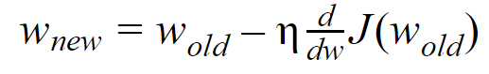
Gradient Descent

Slide 29
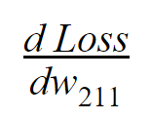
How is Loss related to w₂₁₁?

Slide 30
h₁₁
2.1
o₁₁ = 0.89
W₁₁₁ = 0.5
Input
W₁₁₂ =0.3
h₂₁
W₂₁₁ = -0.23
Output
1
2
Loss
W₁₂₁ = 0.15
1.95
o₁₂ = 0.875
W₂₁₂ = 0.83
1.106
1.793
W₁₂₂ = 0.4
W₂₁₃ = -0.56
W₁₃₁ = 0.65
h₁₃
1.05
W₁₃₂ = -0.3
o₁₃ = 0.741

Slide 31
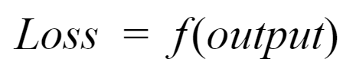
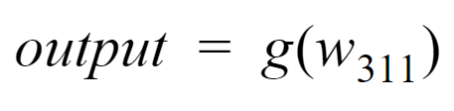
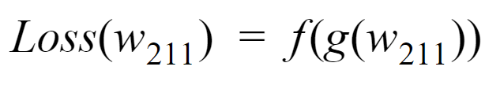

Slide 32
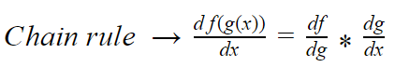
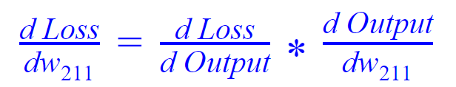

Slide 33
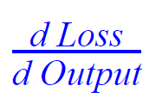
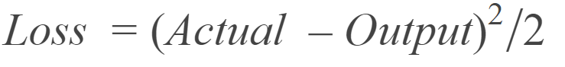
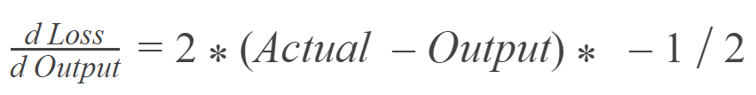
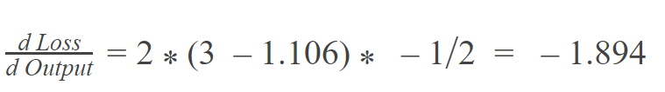

Slide 34
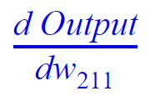
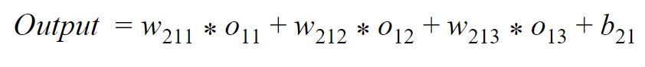
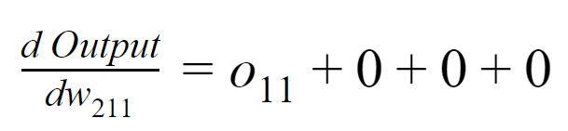
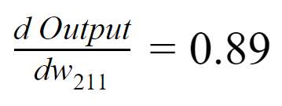

Slide 35
-1.894 * 0.89
= -1.686
What will be new value of w₂₁₁?

Slide 36
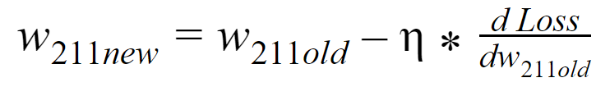
= -0.23 - 0.01 * -1.686
= -0.213

Slide 37
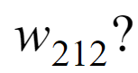
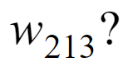

Slide 38
h₁₁
2.1
o₁₁ = 0.89
W₁₁₁ = 0.5
Input
W₁₁₂ =0.3
h₂₁
W₂₁₁ = -0.23
Output
1
2
Loss
W₁₂₁ = 0.15
1.95
o₁₂ = 0.875
W₂₁₂ = 0.83
1.106
1.793
W₁₂₂ = 0.4
W₂₁₃ = -0.56
W₁₃₁ = 0.65
h₁₃
1.05
W₁₃₂ = -0.3
o₁₃ = 0.741

Slide 39
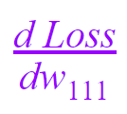
How is Loss related to w₁₁₁?

Slide 40
h₁₁
2.1
o₁₁ = 0.89
W₁₁₁ = 0.5
Input
W₁₁₂ =0.3
h₂₁
W₂₁₁ = -0.23
Output
1
2
Loss
W₁₂₁ = 0.15
1.95
o₁₂ = 0.875
W₂₁₂ = 0.83
1.106
1.793
W₁₂₂ = 0.4
W₂₁₃ = -0.56
W₁₃₁ = 0.65
h₁₃
1.05
W₁₃₂ = -0.3
o₁₃ = 0.741

Slide 41
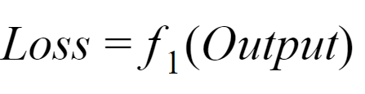
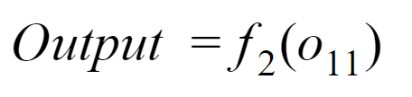
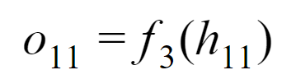
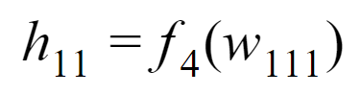

Slide 42
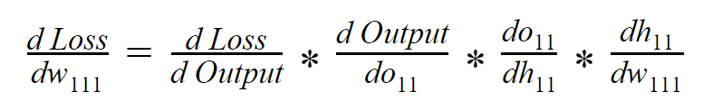

Slide 43
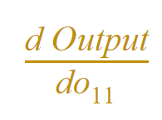
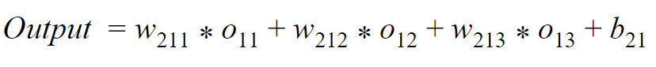
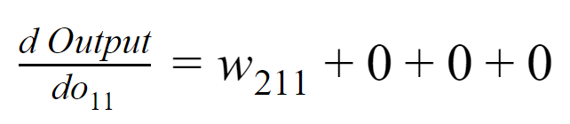
-0.23

Slide 44
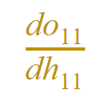
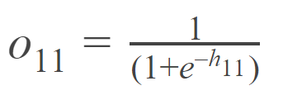
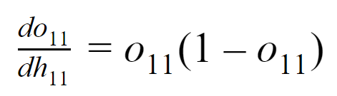
0.89*(1-0.89)
=0.0979

Slide 45
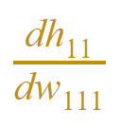
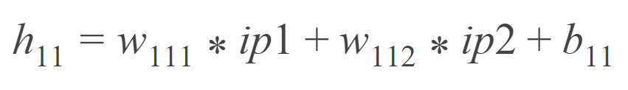
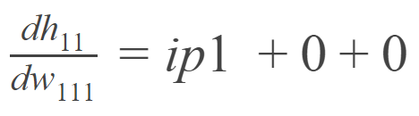
1

Slide 46
-1.894 * -0.23 * 0.0979 * 1
= 0.0426

Slide 47
New value of w₁₁₁
= 0.5 - 0.01 * 0.0426
= 0.499

Slide 48

Usually it’s not pretty
Where should we start?

Slide 49
Hidden Layer
Input
Output
What should be initial weights?

Slide 50

What can be possible issue?

Slide 51

Pick Random Numbers

Slide 52
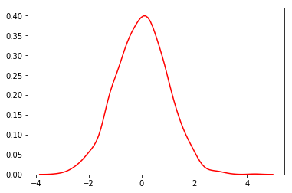
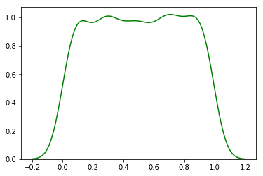
Normal Distribution
Uniform Distribution

Slide 53
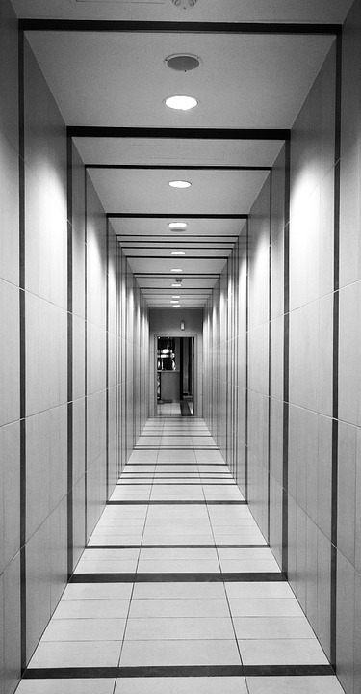
Vanishing Gradient

Slide 54

Exploding Gradient

Slide 55
Search for better Weights initialization

Slide 56
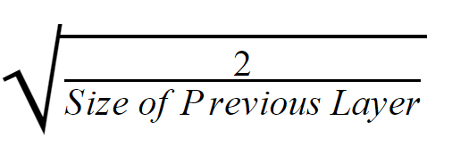
Xavier Initialization

Slide 57
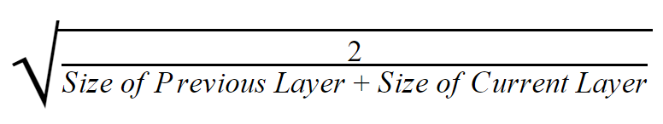
he Initialization

